Slide 1
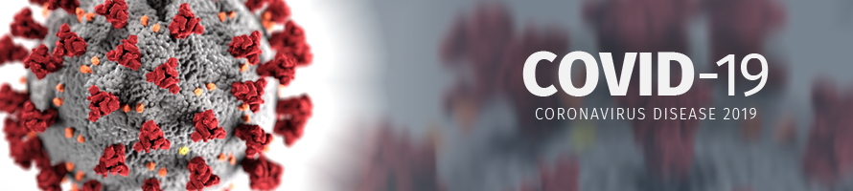
COVID – 19 Vaccination Training Module

Slide 2
Vaccination Training Module
Audience: For frontline health workers, with information for you to pass on to your patients and the community where you live and work.
Author: John Walley, Clinical Professor, Nuffield Centre of International Health & Development, LIHS, Medical School, University of Leeds, UK. The information is summarised by the author from international agency sources, with funding from the RUHF, QMU, but new information is available all the time, and clinical decisions are the responsibility of the physician/ health policy makers who make use of it.
Resources: This COVID-19 Vaccination Training Module is freely available together with a Clinical Deskguide and Training Modules on http://comdis-hsd.leeds.ac.uk
Sources: We have edited from multiple openly available sources: Medical Journals; WHO. UK NHS and Public Health England, and the Nigeria Centre for Disease Control (NCDC). See the reference list at the end.
India vaccine information and questions and answers: https://www.mohfw.gov.in/covid_vaccination/vaccination/index.html
information or http://www.who.int or: nhs.uk/covidvaccine,
You may adapt this module to your country context for non-profit educational use, freely according to the CC0 1.0 Universal (CC0 1.0) Public Domain Dedication https://creativecommons.org/publicdomain/zero/1.0/ . The views expressed are those of the author(s) and not necessarily those of the NHS, the NIHR or the Department of Health.

Slide 3
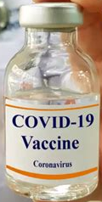
Why is it Important to be Vaccinated? – To Avoid Getting Covid-19!
We need to move towards freedom from the coronavirus that causes Covid-19 disease. This will be by being infected or being vaccinated.
In this module we use the name ‘Covid-19’. So the Covid-19 virus, the Covid-19 vaccine and the Covid-19 disease.
As a health care worker, you are more likely to be exposed to COVID-19 at work due to your higher risk of repeated exposure to the infection. You have the opportunity and responsibility to pass on information to others about the benefits of vaccination, and counter the anti-vaccination myths going around on social media.
Catching Covid-19 can be serious and may lead to long-term Covid complications. Severe Covid-19 is more common in older people who are over-weight, have high blood pressure (BP) or have a chronic disease.
People can have COVID-19 without any symptoms and pass it on to others including those with high risk from coronavirus due to older age or having a chronic disease.
We need to control this pandemic, and encourage everyone to get vaccinated as soon as possible is key to this.

Slide 4
Will the Vaccine Protect Us? – YES!
The COVID-19 vaccination makes our body produce antibodies against the spike protein on the surface of the virus – which stops the virus entering our cells. This will reduce the chance of you suffering from COVID-19 disease. No vaccine is completely effective, and about 1 in 5 persons are still at risk of getting a mild illness - though very few will actually get ill. So, a mild illness is possible. But during the trials, few if anyone were ill enough to need care in hospital. The vaccines are effective, for more information see www.who.int
The effectiveness % in this section are for the original Covid-19 variant and data available in April 2021. However, everywhere there are new variants arising (see the next section). The Brazil and South Africa new variants are of particular concern as they spread more quickly and more often cause severe disease. The vaccines eg AstraZeneca are less effective against the South Africa variant.
The Covid-19 vaccines have been shown to be effective and no safety concerns were seen in randomised controlled trials of more than 20,000 people, eg for the Johnson and Johnson vaccine and similarly for other vaccines.

Slide 5
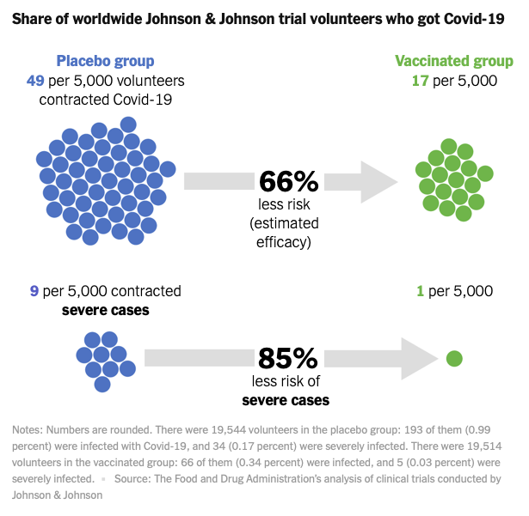
The Johnson & Johnson COVID Vaccination Trial

Slide 6
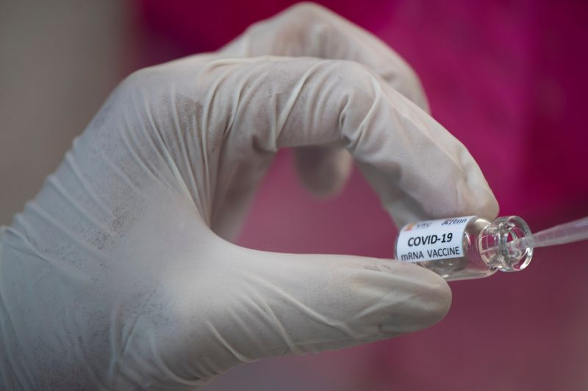
COVID-19 Vaccines
The effectiveness pattern is similar with the other vaccines.
The key message is that all the vaccines are both safe and very effective.
Pfizer and Moderna trials showed an even higher % efficacy, but in part due to conducting the trials in the USA/ Europe when there were no new variants. But Pfizer and Moderna need very low temperature transportation and are expensive. China has not published phase 3 trial data, so its effectiveness or safety is uncertain and is not yet approved by WHO. While the Russian ‘Sputnik V’ vaccine is similar to AstraZeneca.
AstraZeneca was originally trialled in the UK and in South Africa and Brazil where there are new variants, with good results. A recent trial in the USA has given excellent safety and effectiveness (80%). Indeed with 100% protection against death from Covid-19. The vaccination prevented all severe illness - no one needed to go into hospital! It is also produced in India.
WHO has approved and is prioritising the AstraZeneca vaccine, because it is so effective, so safe, and can be stored in a regular fridge/freezer as with the regular childhood vaccines. The production has been funded through UK government aid and so is made available at low cost. This vaccine has also been approved in India, and the WHO Covax scheme is providing it for many countries.

Slide 7
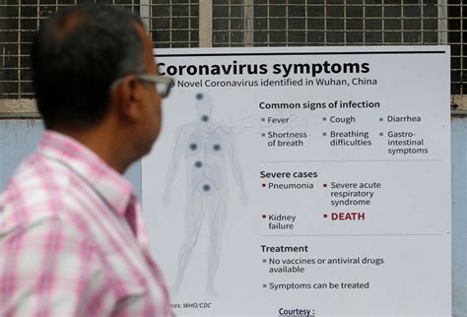
How Do Vaccines Work?
The protection after vaccination is due to our body’s immune system producing antibodies against the virus, stopping the virus getting into the body’s cells.
The immune system also includes activated T white cells that recognise and kill the infected cells.
So, together this stops more viruses being produced, and the patient is protected from illness, or even if the patient gets ill, they won’t get very ill.
https://www.who.int/emergencies/diseases/novel-coronavirus-2019/covid-19-vaccines/explainers

Slide 8
Will the Vaccine Protect Those You Care For? – It Helps a Lot
There have been reports of people getting Covid-19 after being vaccinated, which is not surprising as the effectiveness is not 100%. But remember that it takes up to 2 weeks for the protection after the first dose. So, some people may still get COVID-19 despite having a vaccination, due to infection before or during this 2-week post vaccination period. Even so, the vaccination should lessen the severity of any infection.
For the few who do get Covid-19 infection despite being vaccinated, the illness will be less severe. The vaccinated are less likely to pass infection to their friends and family and to the vulnerable people that they care for.
COVID-19 vaccination reduces the chance of you passing on the virus. But people with the mild or asymptomatic infection are able to pass the virus on.

Slide 9
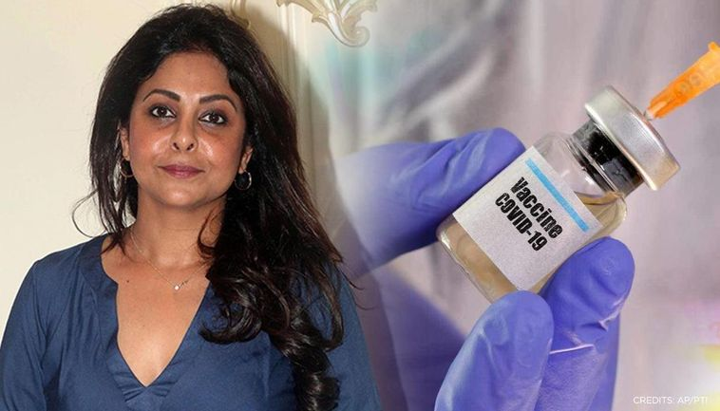
Side effects? - Are Mild as for Other Vaccines
Like all medicines, vaccines can cause side effects. As with other vaccinations, most of these are mild and short-term, and not everyone gets them. Even if you do have symptoms after the first dose, you still need to have the second dose. Although you should get good protection from the first dose, having the second dose should give you longer lasting protection against the virus.
Regina Daniels, Nollywood Actress after her AstraZeneca COVID-19 vaccine. Later she said ‘I took my vaccination 3 days ago and there were no side effects’.
Common side effects are mild and include:
having a painful, heavy feeling and tenderness in the arm where you had your injection.
This tends to be worst around 1 to 2 days after the vaccine
feeling tired
headache, general aches, or mild flu like symptoms.
Advise to take the normal dose of paracetamol (Adults 2 x 4 in 24 hours) and rest to feel better.
Although feeling feverish is not uncommon for 2 to 3 days, a high temperature is unusual and may indicate another infection.
Actress Shefali Shah gets the COVID vaccine and informed about the mild side-effects she witnessed (7 April 2021 RepublicWorld.com)

Slide 10

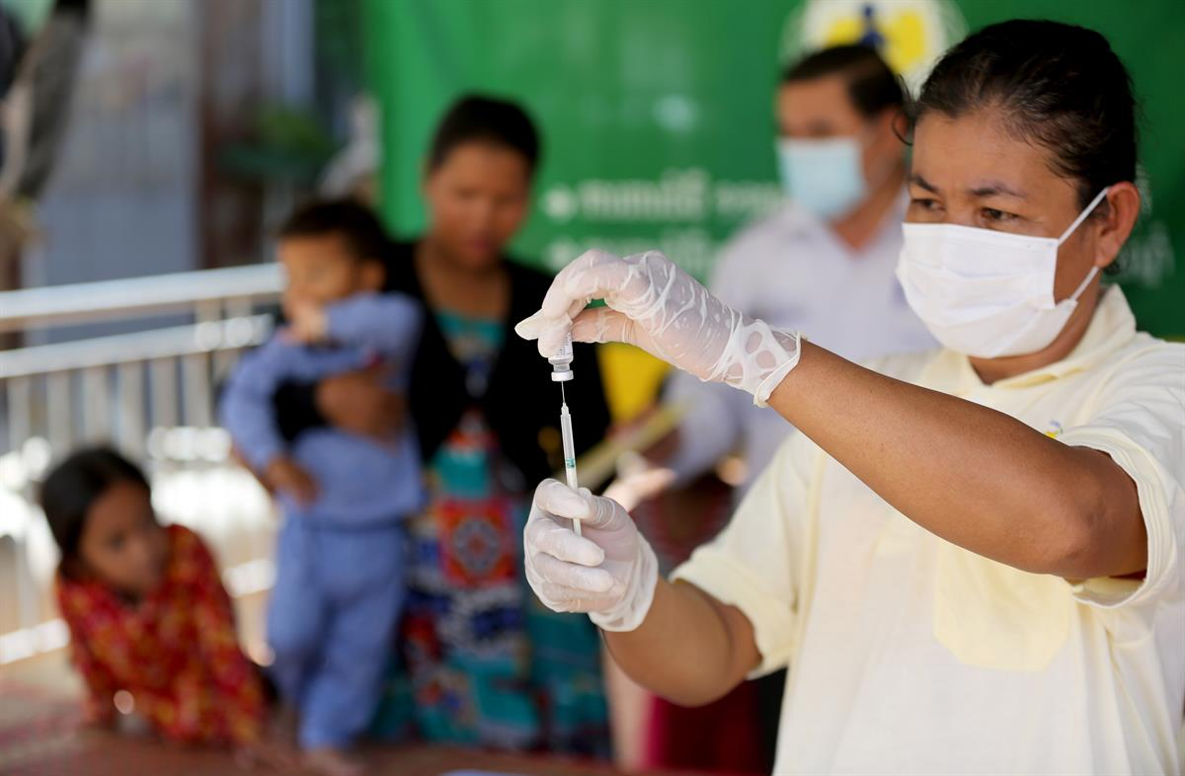
COVID-19 Vaccination Side Effects
During a trial of a new medicine or vaccine, if anyone falls seriously ill it is normal practice to halt and check if anyone gets a serious illness. Usually, it is unrelated to the drug or vaccine (it would have happened anyway). You may have read of this happening e.g. cases of blood clot (thrombosis). These are very rare, and vaccination only adds 1 in a million. But the risk of thrombosis with no vaccination and getting the Covid illness is so much higher.
Very rare serious side effects have been found in the UK, after 36 million doses have been given by mid April 2021.

Slide 11
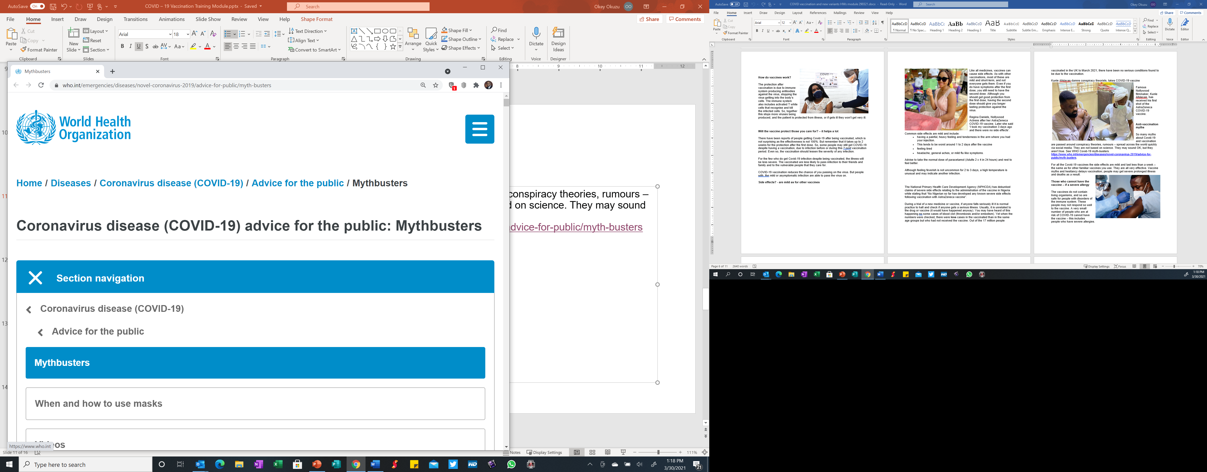
Anti-Vaccination Myths
So many myths about Covid-19 and vaccination are passed around as conspiracy theories, rumours – spread across the world quickly via social media. They are not based on science. They may sound OK, but they aren’t true. See WHO Covid-19 myth-busters. https://www.who.int/emergencies/diseases/novel-coronavirus-2019/advice-for-public/myth-busters
For all the Covid-19 vaccines the side effects are mild and last less than a week – the same as for other familiar vaccines you use. They are all very effective. Vaccine myths and hesitancy delays vaccination; people may get severe prolonged illness and deaths as a result.

Slide 12
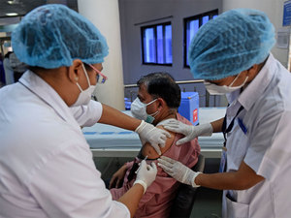
People with allergies
- can have the vaccine
See latest information from Public Health England, or google ‘Allergy UK Covid-19 vaccine’
Vaccinate as normal people who have had:
previous allergic reaction (including anaphylaxis) to a food, insect sting, family history of allergies, reactions at the injection site of a previous vaccination, or if allergy to medicines (except laxatives with PEG).
Only avoid vaccination if an allergy to the constituents of the vaccine, or polyethylene glycol ’PEG’ (some laxatives or a steroid injections). See references, UK MRHA etc. guidance.

Slide 13

Pregnant Women or Women Who Think They May be Pregnant – Delay Taking the Vaccine Until When the Baby Is Born
Like all new medicines, the vaccines have not yet been tested in pregnant women. So, women should wait until their pregnancy is completed before they are vaccinated – but also take care to reduce your risk of COVID-19.
Most women who catch COVID-19 during pregnancy do not suffer a more serious outcome than non-pregnant women and will go on to deliver a healthy baby.
If a woman finds out that she is pregnant after she has had the vaccine, advise her not to worry. The vaccines do not contain organisms that multiply in the body, so they cannot cause COVID-19 infection in the unborn baby.
Women can breast feed after having a vaccination.

Slide 14
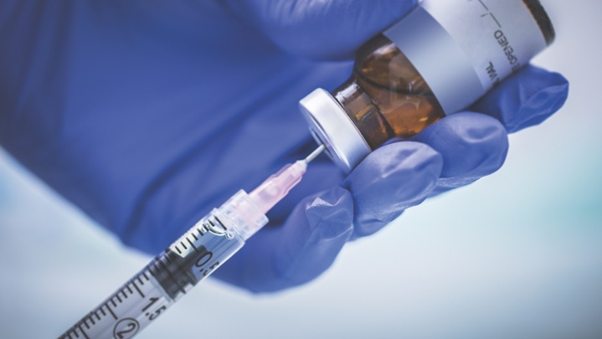
Can you Catch COVID-19 From The Vaccine? - No
You cannot catch COVID-19 from the vaccine. But it takes 2 weeks after the first vaccination to be protected.
So, if you catch COVID-19 from someone (and while incubating but not yet ill) then the symptoms may appear after being vaccinated. But it isn’t due to the vaccination.

Slide 15
Get the Second Dose
Plan to attend the second vaccination appointment. Put an alert in your phone and/or a written record of your next appointment, which should be in 3 to 12 weeks time. It is important to have both doses of the same vaccine to give the best protection.
Make a record, keep it safely and
Go to the appointment for your second dose.

Slide 16
What to Do if You Are Not Well for Your Next Appointment? – Wait a Little…
If you or your patient is unwell, it is better to wait until recovered to have your vaccine, but you should try to have it as soon as possible. You should not attend a vaccine appointment if you are self-isolating, or waiting for a COVID-19 test, or if you have become unwell in the last week with a fever or cough or ‘flu’ symptoms - to avoid infecting others, wait until you are well again.

Slide 17
New Variants of Concern and Future ‘Booster’ Vaccinations
All viruses multiply and sometimes there is a change in the genes. The change in the genes in the virus change is called a mutation. In an epidemic, as with Covid-19, the viruses multiply in huge numbers and changes are arising more quickly. Occasionally a change, ‘mutation’ happens that is helpful to the spread of the virus. So if we control the epidemic by social distancing and vaccination there will be less virus multiplying and so few new mutations occur.
A few new virus variants are better able to transmit, as in the UK and South Africa variants. We call these new ‘variants of concern’.
Advantage to the virus conferred by these mutations, which lead to the classification of “new variants” into “variants of concern”, can manifest in one or more of the following ways:
  faster or more efficient transmission
  increase risk of severe disease or death
  escape immunity from past infection
  escape immunity from vaccination, or
  get past detection by existing tests.

Slide 18
New Variants of Concern and Future ‘Booster’ Vaccinations
A new variant is better at getting past the immune system. It may then infect more people, and/or affect younger adults, as well as more often lead to severe illness. The South Africa and Brazil new variants are like this, and they are spreading around Africa and the world. The AstraZeneca vaccine has been tested against this and was found to be much less effective when given to people exposed to the South African variant. While the Johnson and Johnson vaccine remains reasonably effective (57%) against this new variant. Most of the vaccines haven’t yet been tested against the South Africa or Brazil variants as yet and we don’t know.
But vaccines such as AstraZeneca are being modified to be more effective with these variants of concern, and trials are on-going. People may need boosters with these modified vaccines. We may combine more than one vaccine together. At the time of writing in April 2021, Covid-19 virus is spreading at very high levels in India and elsewhere in south Asia, and new variants are arising. This is a rapidly changing situation. For more information see the ministry of health and family welfare, questions and answers: https://www.mohfw.gov.in/covid_vaccination/vaccination/index.html
So new variants are arising. Some are of concern. But the vaccines are being modified and tested to be effective against them. It is best is to get the vaccine, but then later we may need a booster vaccine dose.
Do counsel people to have the vaccine. But also say that, even after vaccination, to continue social distancing (a meter or more apart), use masks, meet outside or in well ventilated places, and wash their hands with soap or use hand sanitizers often, just as non-vaccinated people must do.

Slide 19
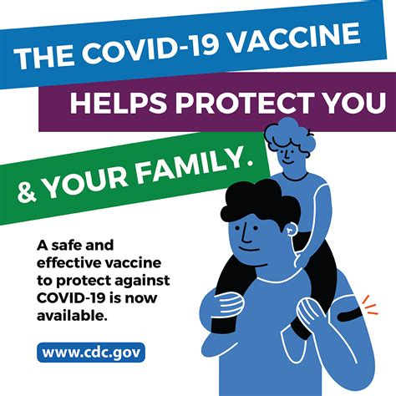

Bollywood stars practice self-isolation
Dynamite news

Slide 20
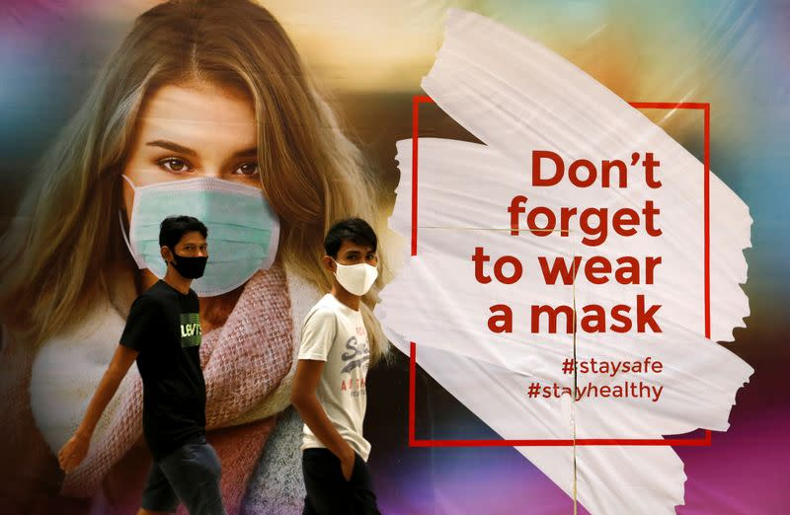
After Vaccination Advise to Follow the Infection Control Advice
Tell your patients and the community that the vaccine cannot give you COVID-19 infection, 1 dose helps a lot, while 2 doses will greatly reduce your chance of becoming ill, and stop you becoming seriously ill. It takes 2 weeks after vaccination for your body to build up protection.
But no vaccine is completely effective, also new variants are spreading, so continue to follow the infection control guidance.
Educate your family, friends, patients, community (and you!) to:
  practise social distancing
  meet outside or in a well-ventilated place
  wear a face mask
  wash your hands carefully and frequently

Slide 21
Covid-19 Cases Are Common – Use clinical guides and counsel patients
Covid-19 symptoms of cough, fever, flu-like aches and pains also occur in other common infections (though loss of taste/ smell is rather specific to Covid). The deskguide will help you recognise the possible Covid-19, counsel and refer for a test. Counsel patients and close family contacts to stay home for 10 - 14 days, to social distancing, masks, hand wash often etc. to minimise infection transmission at home. Also, to go to hospital urgently if they get very breathless, and the other advice as in your national or international Covid-19 guides.
Remember that most people with coronavirus are not recognised to be Covid-19. Even if sent for a test they may not go due to fear of stigma or the cost of travel. For these reasons, there are many more cases than are tested positive and reported in Nigeria, as in other countries. Detailed guides are available from the WHO www.who.int . A concise clinical ‘deskguides’ for health centres and hospitals are available from http://comdis-hsd.leeds.ac.uk and can be adapted to your country context. Keep the guides in your consultation room and use them.

Slide 22
Help Promote The Vaccination To Help Stop Covid-19
Covid-19 will continue to affect our lives and economy until so many people have been infected or vaccinated that transmission drops, this is called ‘Herd immunity’. The immunity from vaccination is better protection than that from the immunity after being infected/ill with Covid-19.
The world has developed excellent and safe vaccinations, and we must encourage people to be vaccinated.
However, because new variants like the South Africa variant and others that will arise it will continue to be a problem. Vaccines are being modified and tested in trials against these. They will be available as booster doses to use in the future. The more we encourage vaccination – as well as social distancing, hand washing etc. – the sooner the epidemic will be controlled and life and work can get back to how it was before.
Health workers, you have a particular role to promote vaccination – spread the word.

Slide 23
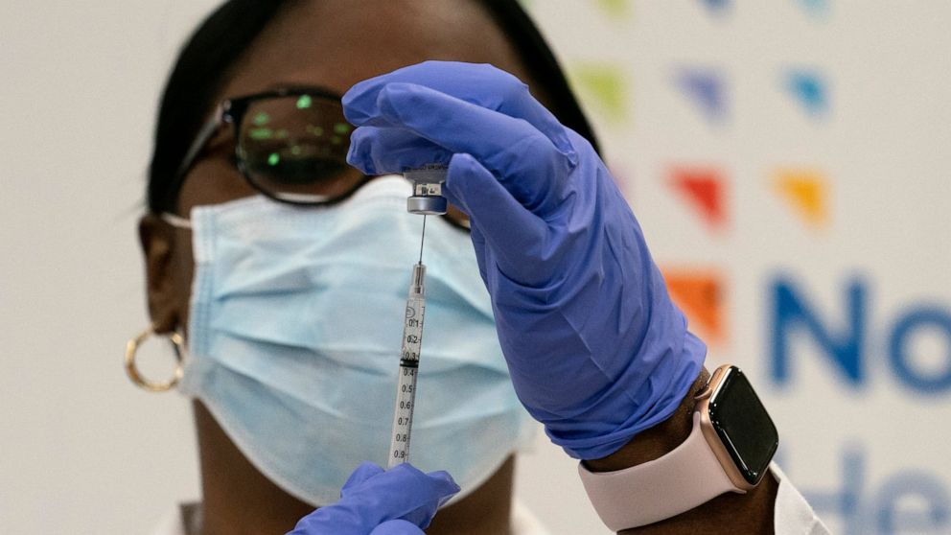
Vaccination Procedures
Vaccinate any adult, with priority to older people and those who are very overweight or have hypertension or chronic health conditions.
Give two doses*, the second 4-12 weeks after the first dose. Transportation and storage as for childhood vaccines.
For the AstraZeneca or Sputnik vaccines you can keep at 2C to 8C in a regular fridge, for up to six months.
(*Johnson and Johnson is one dose only).
It is injected into the muscle of the upper arm – just like many childhood vaccines. Just like your work doing vaccinations for children – be a lifesaver.

Slide 24
References
World Health Organisation (WHO). www.who.int
Madhi, S. A. et al. Preprint at medRxiv https://doi.org/10.1101/2021.02.10.21251247 (2021), included in
Nature Medicine ‘Why vaccines are so difficult to compare’ https://www.nature.com/articles/d41586-021-00409-0
Allergy UK Covid-19 Vaccine. https://www.allergyuk.org/about/latest-news/1374-allergy-and-the-coronavirus-covid19-vaccine
Approval statement on vaccines UK. https://www.allergyuk.org/about/latest-news/1386-mhra-statement-on-the-approval-of-the-oxfordastrazeneca-vaccine-and-update-on-the-use-of-the-pfizerbiontech-vaccine
COVID Protocols https://covidprotocols.org/en/quick-guides,
Clinical overview https://covidprotocols.org/en/chapters/covid-overview/?highlight=primary%20care%20guide
COVID-19, NCD etc. clinical guides, modules and tools. http://comdis-hsd.leeds.ac.uk
India vaccine information, questions and answers: https://www.mohfw.gov.in/covid_vaccination/vaccination/index.html

